Slide 2
A Guide to BYOB Events adapted from materials provided by the Beta Delta Chapter at Miami University

Slide 3
BYOB: BE YOUR OWN BARTENDER
(AKA…Bring YOUR Own Beverage)
Here’s How Members and guests over 21 actually BYOB.

Slide 4
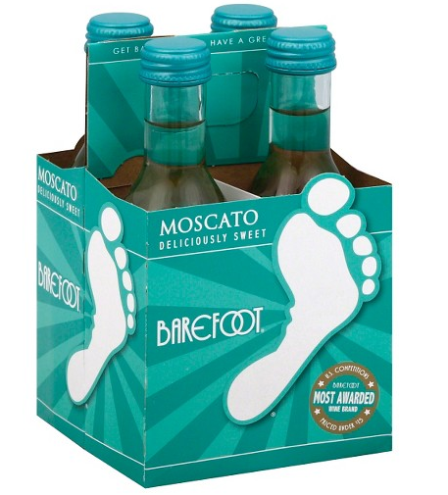
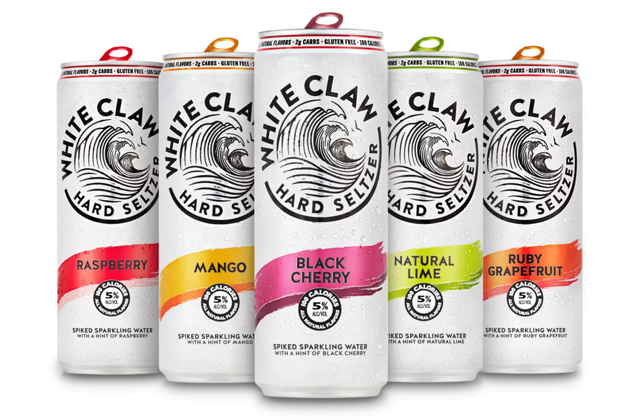
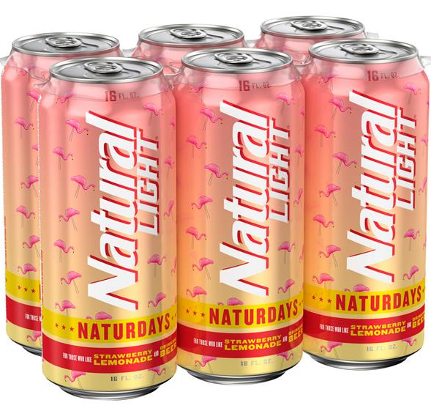
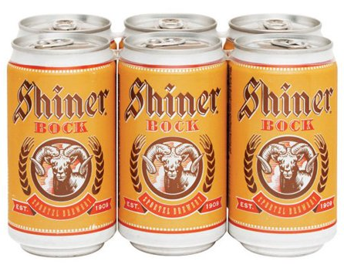
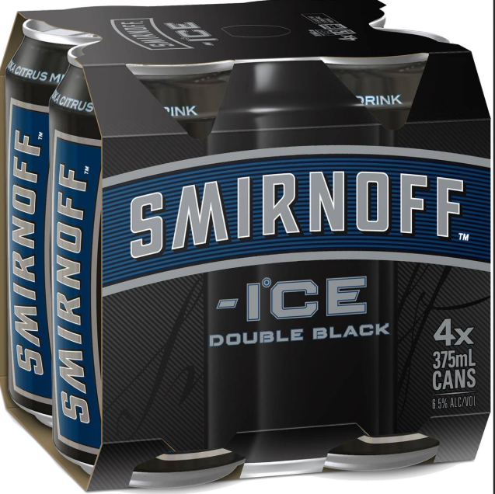
What’s allowed?
Beer, hard seltzer, wine or premium malt beverages
Single serving sizes only
Canned or plastic beverages are recommended. Anything in glass bottles will be poured into plastic cups.

Slide 5
What’s not allowed?
Hard liquor or any beverage over 15% alcohol by volume (ABV)
Any alcohol for members or guests under 21

Slide 6
Before the event
Determine a location where members and guests will meet to check in.
Meet with function monitors or officers coordinating check-in.
Bags, purses, large pockets will be checked.
For members and guests under 21:
Check in and go to your designated bus.
For members and guests over 21:
Note that beverages should be in a bag clearly marked with your name on it.
Remind attendees that function monitors will check IDs and issue wristbands.

Slide 7
Checking in alcohol at the venue
For every event, determine how the drinks individuals
brought will be identified. (this includes members AND guests)
TICKET SYSTEM
Each guest gets one ticket per drink they brought.
The tickets are personalized to the type of drink the guest brought, e.g., Bud Light, Whiteclaw Lime, Naturdays, etc.
A member who is working at the social event checks in each guest’s drink(s) and writes the attendee’s name on the tickets.
The guest redeems tickets one at a time for their drinks at the bar.
An empty can and ticket are required to receive the next drink.
WRISTBAND SYSTEM
The individual’s name and type and number of drinks is written on their wristband with a permanent marker.
A member who is working at the social event checks in each guest’s drink(s).
Each time a guest redeems a drink, an X is added to the wristband.
An empty can is required to receive the next drink.
NOTE: Some wristbands have perforated “pull tabs,” which many chapters have found useful.

Slide 8
During the event
Designate members to work the bar area and distribute alcohol.
Anyone who wishes to acquire an alcoholic beverage they brought to the event must show their wristband or ticket and return an empty can if this is not the first request. Returning the cans assists the chapter with its recycling efforts and helps ensure that alcohol is not being given away to others once it leaves the service center.
No beverages should be distributed to anyone other than the person who brought it
All alcohol will be disposed of at the end of the event.
Only bring what you plan on drinking, because no alcohol will leave the venue.

Slide 9
During the event
The chapter should provide at least one non-alcoholic beverage per person in attendance.
Breads, meats, cheeses, vegetables, cookies, subs, pizza, brownies, fruits and dips are considered appropriate foods. The chapters should avoid serving salty foods.
All food and non-alcoholic beverages should be free to all attendees.
Food and non-alcoholic beverages should be placed in one centralized location.
Non-alcoholic beverages should be served from closed containers.
During the last hour of an event, alcohol service should stop; a new, non-alcoholic beverage and food item should be served for those who wish to switch to non-alcoholic beverages and begin winding down.

Slide 10
Risk reduction and consequences
If you show up visibly intoxicated, you will be turned away.
If you or your date show up with a flask or prohibited type of alcohol, it will be confiscated and thrown away.
If you try to drink on the bus, you will be sent home upon arrival.
If you or your date become visibly intoxicated or ill from overconsumption at the event, you will be sent home by Uber or taxi paid for by you along with your buddy and their date.
All actions, including those listed above, that violate ZTA’s event policies will result in a standards referral.

Slide 11
Tips and reminders
Members over 21: only bring what you will drink!
No unconsumed alcohol will leave the venue.
The buddy system is in full force; look out for and take care of each other.
You are responsible for your date’s behavior.
Water and food will be available for all!

Slide 12
Questions?

